Slide 1
CURRENT PRACTICES: MANAGEMENT OF CENTRAL LINES
IN THE OUTPATIENT SETTING

Slide 2
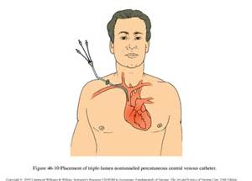
WHAT IS A CENTRAL CATHETER?
CVAD—CENTRAL VENOUS ACCESS DEVICE
THE TIP ENDS UP IN THE SUPERIOR VENA CAVA

Slide 3
CVAD PROS:
RAPID HEMODILUTION OF INFUSATE
CAUSES LESS VENOUS IRRITATION
CAN BE USED FOR LONG PERIODS OF TIME

Slide 4
CVAD CONS:
RISK OF THROMBOSIS
RISK OF INFECTION

Slide 5
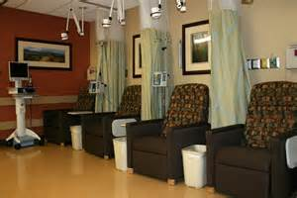
CVADS APPROPRIATE FOR THE OUTPATIENT SETTING
PICC’s
TUNNELED CATHETERS
GROSHONG
HICKMAN
SUB-Q PORTS (IF FREQUENT ACCESS IS NOT REQUIRED)
MEDIPORT
PORTACATH

Slide 6
CVADS NOT APPROPRIATE FOR THE OUTPATIENT SETTING
JUGULAR VEIN CATHS
PERCUTANEOUSLY PLACED SUBCLAVIAN CATHS
PERCUTANEOUSLY PLACED FEMORAL CATHS

Slide 7
WHY?
RESEARCH!
PERCUTANEOUSLY CVADS HAVE INCREASED INFECTION RATES WHEN COMPARED TO TUNNELED CATHS
(HIV CLIENTS TREATED WITH FOSCARNET/GLANCICLOVIR FOR CMV)
ALL CVADS SHOULD BE SINGLE-LUMEN (IN OUTPATIENT SETTING)
IF MULTI-LUMEN
ONE LUMEN SHOULD BE DEDICATED TO TPN ONLY
LABEL IT!
NO: BLOOD, FLUIDS, MEDS, ETC. SHOULD BE INFUSED OR DRAWN FROM THE TPN-DEDICATED PORT

Slide 8
WHO QUALIFIES FOR OUTPATIENT CVAD THERAPY?
1. MUST BE CLINICALLY STABLE
DECREASES RISK OF SUDDEN, LIFE-THREATENING CHANGE IN MEDICAL STATUS
2. MUST HAVE AN ADEQUATE HOME ENVIRONMENT FOR INFUSION THERAPY
3. MUST BE ABLE TO SELF-ADMINISTER INFUSION THERAPY (OR HAVE CARETAKER AVAILABLE TO ADMINISTER)
4. SHOULD (IDEALLY) LIVE WITH SOMEONE WHO CAN RECOGNIZE ADVERSE THERAPY EFFECTS
SOME SIDE EFFECTS ARE LIFE-THREATENING
5. SHOULD BE WILLING AND ABLE TO DEAL WITH NECESSARY ROUTINES ASSOCIATED WITH OUTPATIENT INFUSION THERAPY
VERY IMPORTANT IF PATIENT HAS HISTORY OF ILLICIT DRUG OR ETOH ABUSE, DEMENTIA, CULTURAL CONFLICTS WITH THERAPY OR UNWILLINGNESS TO ADHERE TO THERAPEUTIC REGIMEN

Slide 9
6. MUST HAVE RELIABLE TRANSPORTATION
COMPLEX INFUSION THERAPY AT AN INFUSION CENTER OR AT HOME
SOME TREATMENTS HAVE SIGNIFICANT ADVERSE EFFECTS
TAXI-VOUCHER SYSTEM AT UC/SAN FRANCISCO HOSPITAL FOR EXAMPLE, IF RECEIVING A POTENTIALLY TOXIC THERAPY

Slide 10
OTHER CONSIDERATIONS…
SELECTION OF THE CORRECT DEVICE DEPENDS ON PURPOSE AND IMPACT ON QUALITY OF LIFE
PATIENT PREFERENCE
REPEATED NEEDLESTICKS OKAY?
WANT TO SWIM OR BATHE?
VISUAL ACUITY OK?
PERIPHERAL VENOUS ACCESS GOOD?

Slide 11
TYPES OF CVADS
FOR OUTPATIENT THERAPY

Slide 12
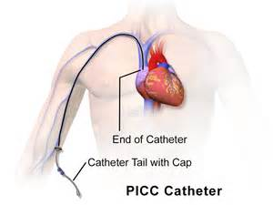
PICC LINES
PERIPHERALLY INSERTED CENTRAL CATHETERS
INSERTED IN CEPHALIC OR BASILIC VEIN IN THE ANTECUBITAL FOSSA
THREADED ALL THE WAY INTO THE SUPERIOR VENA CAVA
BEST FOR CLIENTS WHO REQUIRE DAILY INFUSION THERAPY FOR UP TO 6 MONTHS
NO MAXIMUM DWELL TIME HAS BEEN ESTABLISHED

Slide 13
WHO IS NOT SUITABLE FOR A PICC LINE?
CLIENTS WITH TRAUMATIZED ANTECUBITAL SPACES
HISTORY OF MULTIPLE FAILED CANNULATION ATTEMPTS
VERY ACTIVE CLIENTS
RISK OF DISLODGEMENT
UPPER EXTREMITY MOVEMENT MAY BE LIMITED

Slide 14
DISADVANTAGES OF PICC LINES
RESTRICTED FLOW RATE (SMALL LUMEN)
NEED FOR INTACT VENOUS ANATOMY IN THE ARMS FOR PLACEMENT
INCREASED RISK OF VENOUS THROMBOSIS IN THE EXTREMITY USED
NEED FOR SUTURES TO PREVENT ACCIDENTAL DISLODGEMENT

Slide 15
PICC LINES…
CAN BE INSERTED BY CERTIFIED NURSES OR HEALTH CARE PROVIDERS
IN RADIOLOGY
IN MD’S OFFICE
IN PATIENT’S HOME
XRAY IS REQUIRED TO CONFIRM TIP PLACEMENT
CATHETERS ARE THIN-WALLED AND CAN BURST
FROM HIGH FLOW RATES
FROM EXCESSIVE PRESSURE WHEN FLUSHING
VACUUM BLOOD-COLLECTION SYSTEM
USE 10 ML SYRINGE TO COLLECT BLOOD SPECIMENS

Slide 16
DID YOU KNOW?
IT IS NOT UNCOMMON FOR PATIENTS TO HAVE PHLEBITIS WITHIN THE FIRST 10 DAYS OF INSERTION?
REDNESS WILL EXTEND FROM INSERTION SITE TO SEVERAL INCHES ABOVE IT
ELEVATE ARM
APPLY WARM COMPRESSES
ASSESS FOR CELLULITIS

Slide 17
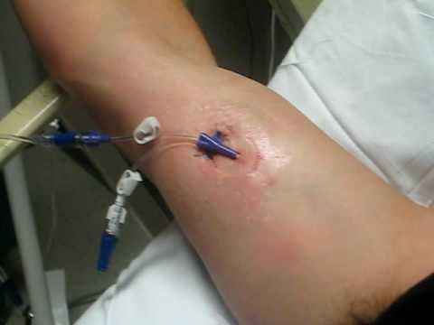
PICC LINE CARE
ASSESS EXTERNAL CATHETER
LEAKAGE
HUB COMMECTION FOR CRACKING
ADMIN SETS/SECONDARY SETS/ADD-ON’s SHOULD BE REPLACED EVERY 72 HOURS
BLOOD SETS/BLOOD PRODUCTS/HYPERALIMENTATION/LIPID EMULSION TUBINGS SHOULD BE REPLACED EVERY 24 HOURS
ASSESS SUTURE PLACEMENT
IF SUTURES MISSING, SECURE UNTIL THEY CAN BE REPLACED

Slide 18
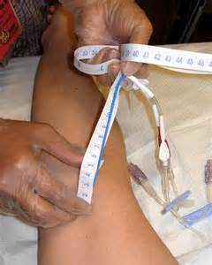
WITH EACH PICC DRESSING CHANGE…
MEASURE EXTERNAL CATH LENGTH AND DOCUMENT
IF EXTERNAL CATH GETS LONGER, MUST HAVE XRAY FOR CHECKING PLACEMENT OF CATH TIP
PROPER FLUSHING CAN HELP PREVENT THROMBOSIS
SASH (SALINE-ADMINISTER DRUG-SALINE-HEPARIN) PROTOCOL
FREQUENCY OF FLUSHING IDLE PICC LINES:
VARIES FROM 8 HOURS TO WEEKLY

Slide 19
S-A-S-H
S—SALINE
A—ADMINISTER DRUG
S—SALINE
H—HEPARIN

Slide 20
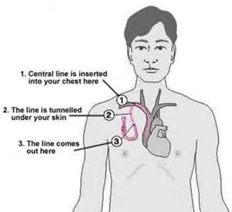
TUNNELED CENTRAL VENOUS CATHETERS
LONG-TERM EXTERNAL CATHETERS
MADE FROM DURABLE, MEDICAL-GRADE SILICONE
“TUNNELED” SUBCUTANEOUSLY BETWEEN VEIN INSERTION SITE AND EXIT SITE
TIP OF CATH IN SUPERIOR VENA CAVA
DACRON CUFF ATTACHED JUST ABOVE EXIT SITE
7-10 DAYS AFTER INSERTION, SCAR TISSUE GROWS ONTO THE CUFF
ANCHORS
PREVENTS INFECTION

Slide 21
TUNNELED CVADS
INSERTED IN
SURGICAL SUITE
INTERVENTIONAL RADIOLOGIC SUITE
EXIT SITE MUST BE DRESSED UNTIL IT HEALS
STERILE GAUZE
TRANSPARENT DRESSING
PREVENT DISLODGEMENT FOR 2-4 WEEKS
CONTINUE TO SECURE TO PREVENT ENTANGLEMENT AND PULLING ON CUFF
WASH WITH SOAP AND WATER
ASSESS DAILY FOR INFECTION
SASH

Slide 22
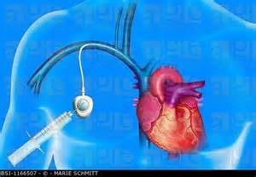
IMPLANTED PORTS
SELF-SEALING SILICONE ENCASED IN TITANIUM OR PLASTIC HOUSING THAT IS ATTACHED TO A SILICONE CATHETER
PORT COMPLETELY UNDER THE SKIN—NO EXTERNAL PARTS
BEST FOR CYCLIC THERAPIES
BEST FOR PATIENTS WHO DON’T WANT EXTERNAL PARTS TO CARE FOR
HUBER NEEDLE IS NEEDED TO ACCESS PORT
TRADITIONAL NEEDLE WOULD LACERATE THE PORT SEPTUM
RESULTS IN BLOOD LEAKAGE
CONTACT WITH AIR

Slide 23
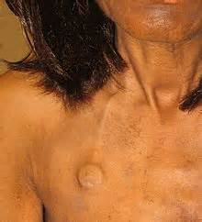
IMPLANTED PORTS…
DESIGNED FOR 500-2000 “STICKS”
PLACED IN CHEST OR ARM
CHEST PORT
PASport
LOWER INFECTION RATES REPORTED
DON’T NEED ROUTINE FLUSHING
BEST FOR INTERMITTENT THERAPY

Slide 24
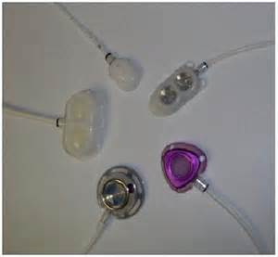
DID YOU KNOW?
DAILY ACCESSING OF IMPLANTED PORTS CAN CAUSE SKIN BREAKDOWN AT THE SITE?
SKIN IRRITATION CAN LEAD TO PORT INFECTION
SURGERY IS REQUIRED TO REMOVE AND INSPECT PORT (WHEN INFECTION IS SUSPECTED)
THEREFORE, INFECTION IS MORE COSTLY AND DIFFICULT TO TREAT WITH PORTS

Slide 25
AFTER PORT PLACEMENT…
SLIGHT EDEMA AND TENDERNESS IS EXPECTED
ACCESS MAY BE DIFFICULT DUE TO EDEMA AND TENDERNESS
IF PORT IS NEEDED IMMEDIATELY, NEEDLE USED IN SURGERY IS LEFT IN UNTIL PORT CAN BE ACCESSED THROUGH THE SKIN
JUST LIKE PICC LINES, THE PASport (TRADE NAME OF AN IN THE ARM PORT) MAY CAUSE PHLEBITIS FOR THE FIRST 10 DAYS OR SO
ASSESS FOR CELLULITIS

Slide 26
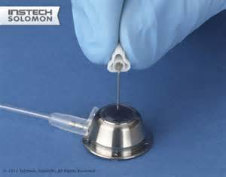
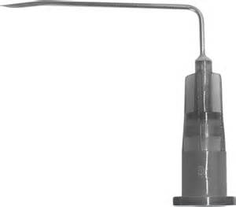
IMPLANTED PORTS…
USE ONLY HUBER NEEDLES
AVOID NEEDLES GREATER THAN 19 GAUGE
ANCHOR NEEDLE IN PORT WITH DRESSING, TAPE
CHECK PLACEMENT BY ASPIRATING BLOOD AND GIVING A SLOW FLUSH OF 5ML NS
NEVER FORCE

Slide 27
GENERAL CARE OF CVADS
IN THE OUTPATIENT SETTING

Slide 28
PROPER CARE SINGLE MOST IMPORTANT FACTOR
REDUCES RISK OF COMPLICATIONS
AT HOME CLIENTS NEED FREQUENT ASSESSMENT OF CARE TECHNIQUE AND CARE SUPPLIES
NO SPECIFIC GUIDELINES EXIST BUT…
USE STRICT ASEPTIC TECHNIQUE WHEN ACCESSING DEVICE
MINIMMIZE CATHETER MANIPULATION DURING ENTRY INTO SYSTEM
PROMPT DRESSING CHANGES IF WET, LOOSE, SOILED
ROUTINE FLUSHING OF LINE WHEN NOT IN USE
REMOVAL OF CATHETERS WHEN NO LONGER NEEDED

Slide 29
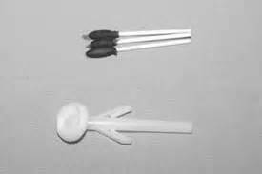
EXIT-SITE CARE AND DRESSINGS
SKIN CLEANSING
ALCOHOL + POVIDONE IODINE
CHLORHEXIDINE**(2% WORKS BEST)
OINTMENTS HAVE NOT DEMONSTRATED EFFECTIVENESS IN PREVENTING INFECTION AT SITE
CDC RECOMMENDS CHECKING MANUFACTURER’S RECOMMENDATIONS REGARDING COMPATIBILITY

Slide 30
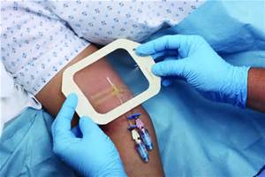
EXIT SITE CARE AND DRESSINGS
OCCLUSIVE DRESSINGS
RESEARCH IS MIXED ON EFFECTIVENESS
TRANSPARENT DRESSINGS SHOULD:
HAVE HIGH WATER PERMEABILITY
KEEPS SITE DRY
ASSESS SKIN INTEGRITY
SWEATING
SENSITIVITY
DRESSING SHOULD BE INDIVIDUALIZED TO PATIENT
CDC HAS NO RECOMMENDATIONS BUT…
GAUZE MAY BE BETTER FOR BLEEDING OR OOZING SITE
ASSESS FOR REDNESS, SWELLING, TENDERNESS, DRAINAGE

Slide 31
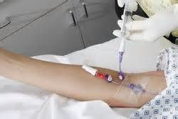
FLUSHING CVADS
ALL REQUIRE ROUTINE FLUSHING WHEN NOT IN USE
MAINTAIN PATENCY
MINIMIZE THROMBOTIC COMPLICATIONS
FREQUENCY VARIES WITH DEVICE TYPE
NS GENERALLY RECOMMENDED
CONCENTRATION OF HEPARIN DIFFERS WITH DEVICE USED AND PATIENT’S CONDITION
GENERALLY, LOWEST EFFECTIVE CONCENTRATION OF HEPARIN SHOULD BE USED
VOLUME OF HEPARINIZED SALINE SHOULD BE ROUGHLY TWICE VOLUME OF CANNULA

Slide 32
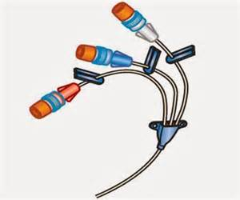
FLUSHING CVADS
SOME CVADS HAVE 2-WAY VALVES
PREVENT BLOOD BACK-UP INTO CATH
GROSHONG CATHETERS, FOR EXAMPLE
MAY BE FLUSHED WEEKLY WITH NS ONLY

Slide 33
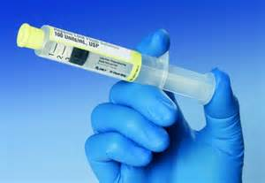
FLUSHING CVADS
MEDS MAY NOT BE COMPATIBLE WITH HEPARIN
MUST FLUSH BEFORE AND AFTER EACH DIFFERENT MED WITH SALINE
FLUSH WITH HEPARIN AFTER LAST SALINE FLUSH
IF DRAWING BLOOD FROM A DEVICE
DISCARD FIRST 5-10 ML OF BLOOD

Slide 34
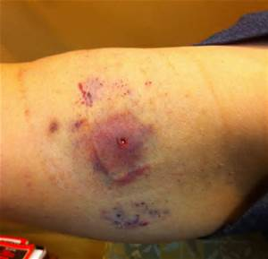
CVAD COMPLICATIONS

Slide 35
PERI-PROCEDURAL
PNEUMOTHORAX
HEMATOMA
AIR EMBOLISM
CARDIAC ARRHYTHMIA
ARTERIAL PUNCTURE
PLEXUS IRRITATION
PERFORATION OF HEART AND GREAT VESSELS

Slide 36
POST-INSERTION
PHLEBITIS
INFECTION**
SEPTICEMIA
SVC SYNDROME
OCCLUSION OF SUPERIOR VENA CAVA
VENOUS THROMBOSIS**
TORSION OF THE PORT RESERVOIR
CATHETER FRACTURE OR EMBOLISM
PINCH-OFF SYNDROME FOR TUNNELED CATHETERS
CATH COMPRESSED BETWEEN FIRST RIB AND CLAVICLE
**MOST COMMON COMPLICATIONS

Slide 37
OTHER COMPLICATIONS
CATHETER MIGRATION
RARE
CATHETER FRACTURE SIGNS AND SYMPTOMS:
CHEST WALL SWELLING AT INSERTION SITE
PAIN IN THE SHOULDER OR PORT AREA WITHOUT SWELLING
RESISTANCE TO INJECTION OR WITHDRAWAL OF FLUIDS
SUDDEN ONSET OF CHEST PAIN OR COUGH
REPAIR KITS FOR BROKEN HUBS AND EXTERNAL TUBING

Slide 38
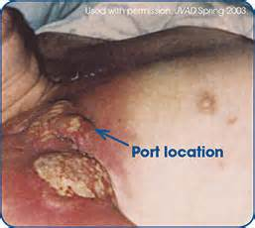
OTHER COMPLICATIONS
EXTRAVASATION
CAUSED BY:
NEEDLE DISLODGMENT
DAMAGE TO CATHETER
FIBRIN AND THROMBUS FORMATION
CAUSES OCCLUSION AND LEAKAGE
ASSESS CATH FUNCTION BEFORE ADMINISTERING CHEMO
ASSESS SITE FOR:
REDNESS
SWELLING
TENDERNESS
PT COMPLAINTS DURING INFUSION

Slide 39
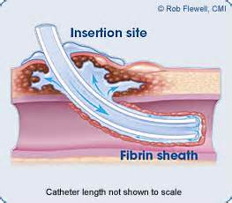
CVAD THROMBOSIS
CAUSES
PLATELET DEPOSITION ON FOREIGN SUBSTANCES
FIBRIN SHEATHS (5-7 DAYS)
CATHETER TIP PLACEMENT DIFFICULTIES
VENOUS IRRITATION
FROM CHEMOTHERAPY
HIGH OSMOLARITY SOLUTIONS
DRUG PRECIPATION WITHIN CATHETER
VENOUS STASIS FROM TUMOR COMPLRESSION

Slide 40
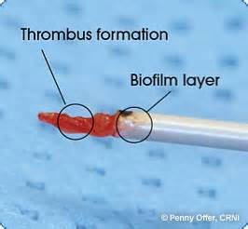
CVAD THROMBOSIS SYMPTOMS
DIFFICULTY IN ASPIRATING FROM THE CATH
MAY HAVE NO SYMPTOMS IN EARLY STAGES
SHOULDER OR ARM PAIN
UNILATERAL SWELLING OF ARM, NECK, OR FACE
CYANOSIS
VENOUS DISTENTION OR PALPABLE VENOUS CORD
PROMINENT SUPERFICIAL VEINS
SVC CYNDROME OR PULMONARY EMBOLUS

Slide 41
CVAD THROMBOSIS DIAGNOSIS/TREATMENT
CONFIRMED WITH:
X RAY STUDIES (WITH CONTRAST)
ULTRASOUND
CT SCANNING
TREATMENT INCLUDES:
LOW-DOSE t-PA (TISSUE-TYPE PLASMINOGEN ACTIVATOR—CathFlo Activase)

Slide 42
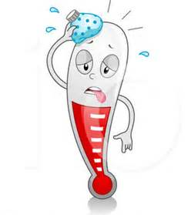
CVAD INFECTION
MOST COMMON COMPLICATION
CAUSES:
CONTAMINATED INFUSATE
CONTAMINATION AT IV TUBING JUNCTIONS
CONTAMINATION AT INSERTION SITE
SYSTEMIC SEEDING FROM DISTANT SOURCE

Slide 43
CVAD INFECTION
LOCAL OR SYSTEMIC
LOCAL INCLUDE:
INSERTION OR EXIT-SITE INFECTIONS
PORT OR RESERVOIR INFECTIONS
TUNNEL INFECTIONS
SYMPTOMS:
INFLAMMATION WITH OUR WITHOUT PURULENT DRAINAGE
LOCALIZED PAIN
ERYTHEMA
INDURATION
TENDERNESS
PREVENTION:
STRICT HAND WASHING
ASEPTIC TECHNIQUE
PROPER SKIN PREP

Slide 44
CVAD INFECTION
SYSTEMIC INCLUDE:
BACTEREMIA OR SEPTICEMIA
SUPPURATIVE THROMBOPHLEBITIS
ENDOCARDITIS OR ETASTATIC ABCESSES
IS RARE, BUT CAN BE LIFE-THREATENING
SYMPTOMS:
FEVER
CHILLS
HYPOTENSION
HYPERVENTILATION
ALTERED MENTAL STATUS
NONSPECIFIC GASTROINTESTINAL COMPLAINTS
NAUSEA
ABDOMINAL PAIN

Slide 45
CVAD INFECTIONS
REMEMBER!!
IMMUNOSUPPRESSED CLIENTS MAY HAVE NO SYMPTOMS!!
DIAGNOSIS INCLUDES:
BLOOD CULTURES
SITE CULTURES
CATHETER TIP CULTURES

Slide 46
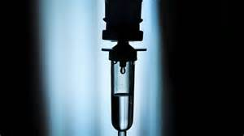
CVAD INFECTIONS
TREATMENT INCLUDES:
UNCOMPLICATED INSERTION/EXIT SITE INFECTIONS:
FREQUENT SITE CARE
10-14 DAYS OF ANTIBIOTICS
TUNNEL, TRACT, OR POCKET INFECTIONS
USUALLY REQUIRE REMOVAL
7-10 DAYS OF ANTIBIOTICS

Slide 47
IV THERAPY IS COMING TO A HOME NEAR YOU!
CONVENIENCE
DECREASED EXPOSURE OF IMMUNOCOMPROMISED PATIENTS TO NOSOCOMIAL INFECTIONS
DECREASED ACUTE CARE COSTS

