Slide 1
Anatomy and Physiology in IV THERAPY
Cindy May, BSN, RN
Practical Nursing Instructor
JONES County Jr. college

Slide 2
Learning Outcomes
Describe the anatomical structures and functions of veins utilized as venipuncture sites
Differentiate the anatomic characteristics of veins and arteries.
Identify and select appropriate veins commonly used for venipuncture.

Slide 3
Skin
Skin-protects the body from the environment and is a natural barrier to external forces
Two layers:
    Epidermis
    dermis

Slide 4
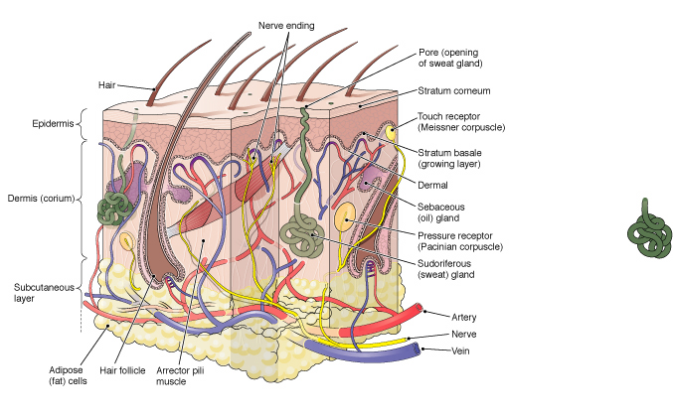

Slide 5
Epidermis
Outer layer
5-7 cells thick
Composed of stratified squamous keratinizing epithelium cells
Keratin - the protein in the epidermal cells that make the skin relatively waterproof
Forms a protective covering for the dermis
Mitosis constantly renews this layer, which forms a barrier between the body and the external environment
Notes:
EPITHELIAL Cells that are keratinized prevent diffusion of nutrients and water from our skin. These cells die quickly so frequent replacement is necessary.

Slide 6
Dermis
Inner layer
Composed of modified fibrous connective tissue
Thicker
Contains accessory structures such as blood vessels , hair follicles, sweat glands , small muscles, and nerves
Highly sensitive and vascular
Contains many capillaries
Contains thousands of free nerve endings

Slide 7
Dermis (cont’d)
    Many sensory receptors
    Reacts quickly to painful stimuli, temperature changes, and pressure sensations
    MOST PAINFUL LAYER DURING VENIPUNCTURE
    Inner surface of wrist highly sensitive area- only use this area when no other choice

Slide 8
Subcutaneous tissue
Thickness varies, thinnest on eyelids, thickest abdomen
When cannula is located here there is free movement of skin
Aseptic technique important infection spreads easily
Cellulitis-inflammation of the skin and connective tissue usually localized

Slide 9
Artery
Supplies circulation to a particular area. If damaged, the related area will suffer from impaired circulation and possibly from necrosis and gangrene
Located in deep tissue and protected by muscles
Large vessels carry blood away from the heart
Arteries pulsate

Slide 10
Veins
Many veins supply one area if one is injured, others will maintain circulation
Superficially located
Transport blood at a lower pressure
Transport blood and fluid back to the heart for circulation
Do not pulsate

Slide 11
Peripheral Veins
Similar to arteries because:
They transport blood and that is it!
Veins are thinner than arteries and transport blood at a much lower pressure
Veins have three layers
Receive waste-rich blood from the capillaries and transport it to the heart and lungs.

Slide 13
Valves in Veins
  Prevent backflow
  Allow blood to flow against force of gravity
  When starting and IV, AVOID:
  Accessing a vein near a valve
    Catheter can be come occluded when the valve closes if the tip lies within the valve
  Locations at which veins cross over joints
  Areas near previous IVs or venipunctures

Slide 15
Site Selection for Peripheral IVs
General rules for site selection:
      Start distally and work proximally
      Avoid patient’s dominant hand
      Use feet or legs only if arms are inaccessible

Slide 16
Site Selection for Peripheral IVs
Specific rules for site selection:
      Choose peripheral veins that are:
        Straight and large
        Easily accessible
        Surrounded by healthy subcutaneous tissue
        Use largest, most prominent vein
        for first attempt
        (cont’d)

Slide 17
Site Selection for Peripheral IVs
Specific rules for site selection:
Use upper extremities in order of preference:
      Dorsal surface of hand
      Radial and ulnar veins of forearm
      Cephalic vein
      Basilic vein

Slide 18
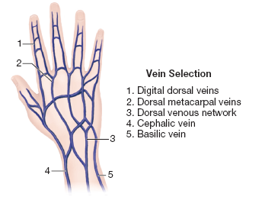

Slide 20

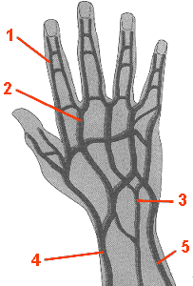
A Closer Look……..
Digital dorsal veins - #1
  Runs lateral along the fingers and thumb
  Not usually an initial choice, used as a last resort
  Subject to mechanical phlebitis
  If used, should use a finger splint to immobilize
  Only small gauge catheters.

Slide 21
A Closer Look……..
Dorsal metacarpal veins - #2
  Back of hand
  Most distal site of extremity
  Tip of catheter should not extend over the bend of the wrist joint
  The hub should not extend over the knuckles
  Catheter should lie flat on the back of hand
  Not used for vesicants

Slide 22
A Closer Look……..
Dorsal Venous Network - #3
  Larger vein
  Usually comfortable for patient
  Angle of vein may prevent using as viable site
  Avoid placement over wrist to prevent risk of mechanical phlebitis
  Not suitable for vesicants

Slide 23
A Closer Look……..
Basilic vein - #4
  Runs the entire length of the arm from wrist to axilla
  Located on ulnar side of arm
  Fairly large
  Numerous valves

Slide 24
Another Look……..
Basilic vein - #5 Wrist Area
  Runs entire length of arm on ulnar side
  In forearm, bones provide natural splint
  Accommodates larger catheters

Slide 25
A Closer Look……..
Cephalic vein - #5
  Runs entire length of arm on radial side
  In forearm, bones provide natural splint
  Accommodates larger catheters

Slide 26
Another Look……..
Cephalic vein - #4 Wrist Area
  Runs entire length of arm on radial side
  In forearm, bones provide natural splint
  Accommodates larger catheters

Slide 27
A Closer Look……..
Median antebrachial vein - #6
  Sometimes easy to visualize, difficult to palpate
  Located on the underside of the forearm
  Medium size
  Runs in close proximity to ulnar nerve

Slide 28
A Closer Look……..
Median antebrachial vein - #6
  Sometimes easy to visualize, difficult to palpate
  Located on the underside of the forearm
  Medium size
  Runs in close proximity to ulnar nerve

Slide 29
A Closer Look……..
Median cubital vein - #2
  Lies in the antecubital fossa
  Large vein, easily accessed and visualized: used for quick access
  Used to draw blood
  Use for limited time due to joint articulation and limit to patient mobility

Slide 30
A Closer Look……..
Accessory cephalic vein - #3
  Branches off the cephalic
  Located on top of forearm

Slide 31
Have you ever heard?......
“ I don’t have any veins….. ”
“ My veins roll…… ”
“ I hope you know what you are doing, because the last time I had an IV, 25 people stuck me…….. ”
“ I hope you know what you are doing, because usually the doctor has to stick me……. ”

Slide 32
What does it mean?
Everyone definitely has veins!
May be dehydrated
May have small veins, heredity or overuse
Rolling veins are difficult, but can be accessed with adequate stabilization.
Some people have more adipose and subcutaneous tissue, still have veins, just harder to access!

