Slide 1
THINKING OUTSIDE THE BOX
IV THERAPY IN NON-TRADITIONAL SETTINGS
THE RISE OF THE AMBULATORY HYDRATION CLINIC

Slide 2
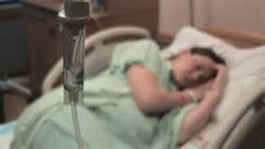
BACK IN THE DAY…
IV’S WERE ONLY GIVEN IN HOSPITALS
DURING TIMES OF WAR, THEY WERE GIVEN ON THE BATTLEFIELD OR IN MILITARY FIELD HOSPITALS
COULD ALSO BE GIVEN IN AMBULANCES—PRE HOSPITAL TREATMENT

Slide 3
RECENTLY…
PHYSICIAN’S OFFICES BEGAN ADMINISTERING CHEMOTHERAPY IN THEIR OWN CLINICS
MORE AND MORE THERAPIES AVAILABLE IN IV FORM
OUTPATIENT SURGERY AND DIAGNOSTIC SERVICES ALSO PERFORMED IV THERAPY OUTSIDE OF THE HOSPITAL
THEY WERE STILL HIGHLY REGULATED CLINICAL SETTINGS
TREATED AS AN EXTENSION OF THE HOSPITAL SETTING
ARE EQUIPPED TO HANDLE COMPLICATIONS/EMERGENCIES

Slide 5
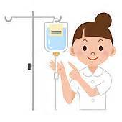
ALL OF THESE SETTINGS HAD SOMETHING IN COMMON…
THEY ADMINISTERED:
PHYSICIAN-DRIVEN/RECOMMENDED THERAPIES
LIFE SAVING THERAPIES
DISEASE-FIGHTING THERAPIES
CONDITION-TREATING THERAPIES
THROUGH THE IV ROUTE

Slide 6
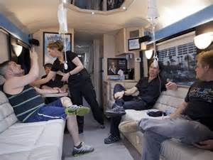
FAST-FORWARD TO 2016…
IV THERAPY IS OFFERED IN MORE NON-TRADITIONAL SETTINGS THAN EVER
HOME SETTING
INFUSION CENTERS
PRETTY TRADITIONAL SERVICES
SPA-TYPE CLINICS
NOT YOUR MAMA’s IV SETTING!

Slide 7
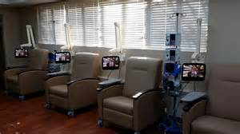
INFUSION CENTERS
THESE CLINICS ADMINISTER IV THERAPY FOR A VARIETY OF CONDITIONS
SUPERVISED BY PHYSICIANS
MUCH MORE OF A “TRADITIONAL” OUTPATIENT SETTING

Slide 8
INFUSION CENTERS TREAT…
MIGRAINES
CHEMOTHERAPY
IMMUNE DEFICIENCIES
AUTOIMMUNE DISEASES
ACUTE INFECTIONS
GUILLAIN BARRE SYNDROME
TRANSPLANT RECOVERY
MS
ALS
CHRON’S DISEASE
RHEUMATOID ARTHRITIS
KAWASAKI DISEASE
IDIOPATHIC THROMBOCYTOPENIA PURPURA

Slide 9
THE MEDICATIONS THAT ARE USED…
MgSO4
ANTI-NAUSEANTS
STEROIDS
IMMUNOGLOBULIN THERAPY
TYSABRI
CHEMO AGENTS
BLOOD AND BLOOD PRODUCTS
MONOCLONAL ANTIBODIES
PAIN MANAGEMENT
ANTIBIOTICS
AND A HOST OF OTHERS

Slide 10
THE SPA-TYPE AMBULATORY/PROPRIETARY CLINICS TREAT….
HANGOVERS
FLU
SIMPLE HYDRATION
VITAMINS
MINERALS
ATHLETES
ENERGY
ENHANCE BEAUTY
ANTIOXIDANT THERAPY
CLEANSES
JET LAG
ANTI-AGING
“JUST BECAUSE”

Slide 12
THEY GIVE…
LACTATED RINGERS
NORMAL SALINE
TORADOL
ZOFRAN
DEXTROSE
B12
AMINO ACIDS
VITAMIN C
ANTI-HEARTBURN
AND OTHERS
ALSO INJECTIONS
HCG DIET THERAPY

Slide 13
SOME FACTS…
THESE ARE BUSINESSES—THESE ARE “IV STORES”
THE STAFF CONSISTS OF A PHYSICIAN
WHO ORDERS THE INFUSION AND ITS CONTENTS
NURSES, NURSE PRACTITIONER’S, EMT’S OR UNLICENSED PERSONNEL
THEY START THE DRIPS
THEY MONITOR THE CLIENTS

Slide 14
THE CLAIMS
HYDRATE THE BODY
GET RID OF HANGOVERS
REMOVE TOXINS WHILE BOOSTING IMMUNITY
IMPROVING YOUR HAIR, SKIN AND NAILS
PRODUCE COLLAGEN
REDUCE WRINKLES
FEEL BETTER QUICKER

Slide 15
THE SETTINGS…
A BUS (!)
HANGOVER HEAVEN IN LOS VEGAS
REVIVE AND REVIVEME
REMEDY ROOM
VIDA FLO
SPA-LIKE CLINICS
WALK-INS OFF THE STREET

Slide 17
WHY?!?!?!?
BY-PASSES THE ER
GIVES THE CONSUMER CHOICES
GREAT FOR THE UNINSURED
GREAT FOR THOSE WITHOUT HEALTH CARE ACCESS
RELATIVELY INEXPENSIVE
WHEN COMPARED TO AN ER VISIT
WILL ACCEPT CASH
ANONYMOUS

Slide 19
HOW DOES IT WORK?
IF YOU HAVE FLU, VOMITING, A HANGOVER, DIARRHEA, ETC., YOU CAN COME IN AND GET SOME FLUIDS
PATIENTS OFTEN FEEL BAD, BUT NOT BAD ENOUGH FOR AN ER VISIT
IT REHYDRATES QUICKLY, THUS MAKING THE PATIENT MORE PRODUCTIVE MORE QUICKLY
GIVES THE PATIENT MORE CHOICE IN HEALTH CARE OPTIONS
WAIT TIMES AND TREATMENT TIMES ARE SHORT

Slide 20
A CLIENT WALKS IN TO A HYDRATION CLINIC…
EXPLAINS THE S/S THE CLIENT HAS BEEN HAVING
H/A, DRY MUTH, NAUSEA, VOMITING, INABILITY TO SLEEP, ETC..
DESCRIBES THE BENEFITS THE CLIENT WISHES TO ACHIEVE
A BRIEF HEALTH HISTORY IS TAKEN WITH EMPHASIS ON CHRONIC CONDITIONS, PAST SURGERIES AND ALLERGIES
VITAL SIGNS ARE TAKEN
MANY WILL QUESTION HOW MAY TIMES A DAY THE PATIENT URINATES AND WHAT COLOR THE URINE IS

Slide 21
IF THE CLIENT HAS A SERIOUS CONDITION…
MANY WILL NOT TREAT CLIENTS WITH A SERIOUS CHRONIC HEALTH CONDITION
ELDERLY, OBESE, DIABETICS, CIRCULATORY OR RENAL DISORDERS
SOME ARE REFERRED TO THE ER
SERIOUS CONDITIONS THAT REQUIRE IMMEDIATE ATTENTION
FOR EXAMPLE: IS IT INTESTINAL FLU OR APPENDICITIS?

Slide 22
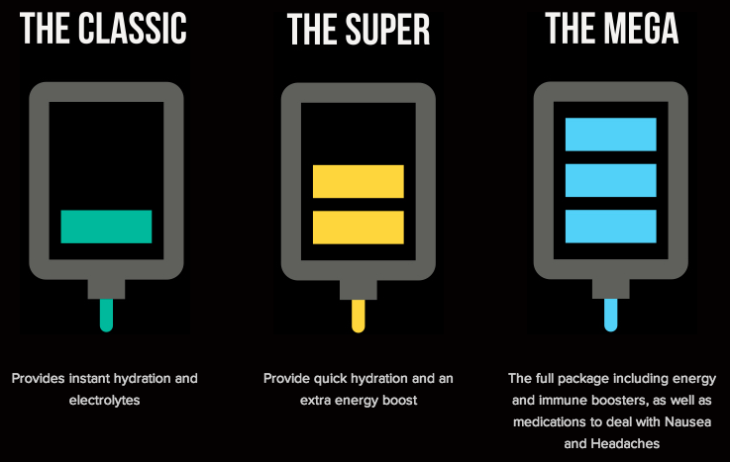
IF YOU HAVE…
COLD AND/OR FLU
LR
VIT. C AND B COMPLEX
HANGOVER
RL PLUS TORADOL, ZOFRAN
ENERGY BOOST
B VITAMIN COMPLEX

Slide 24
NEXT…
PATIENT IS LED TO A TREATMENT AREA WHERE THE IV IS INSERTED
THIS MAY BE THE MD, THE NURSE, OR AN UNLICENSED PERSON CERTIFIED BY THE MD OVER THE CLINIC
THE PATIENT THEN GOES TO A LOUNGE WHERE HE/SHE MAY:
LIE DOWN IN A DIMLY-LIT AREA
UTILIZE THE FREE WI-FI IF THEY WANT TO WORK
GO TO A LIVING ROOM WHERE THEY CAN TALK WITH OTHERS AND WATCH TV OR MOVIES
SOME HAVE VIP AREAS FOR PROFESSIONAL ATHLETES, CELEBRITIES

Slide 26
THE IV RUNS ITS COURSE
PATIENTS REPORT FEELING BETTER AND RESUME THEIR DAILY ACTIVITIES
REVIEW SITES LIKE YELP ARE FULL OF GLOWING REVIEWS

Slide 27
TYPICAL F.A.Q’s. (FROM ONE CLINIC’S WEBSITE)
HOW LONG DOES IT TAKE FOR AN IV?
30-45 MINUTES FROM START TO FINISH
EXTRA THERAPIES WILL TAKE EXTRA TIME
HOW MUCH DOES AN IV COST?
ANYWHERE FROM $70.00 ON UP
DEPENDS ON ADDITIVES
WHO CAN GET AN IV?
ALMOST EVERYONE OVER 18
YES, PREGNANT AND BREAST-FEEDING WOMEN CAN BE TREATED AS WELL

Slide 28
F.A.Q’s.
HOW DO IV’S WORK?
REPLENISH FLUIDS, ELECTROLYTES, VITAMINS
BY-PASSES GI TRACT, PROVIDING INSTANT ABSORPTION
WHAT IS IN THE IV?
NS, RL, WHATEVER IS NEEDED
APPROPRIATE ADDITIVES
MEDICINES, VITAMINS, NUTRIENTS
WHO ADMINISTERS THE IV?
NURSES, DOCTORS, UNLICENSED TRAINED PERSONNEL

Slide 29
F.A.Q’s.
DOES IT HURT TO GET AN IV?
CAN USE SUB-Q NUMBING VIA NEEDLE, CREAM, OR AIR INJECTION (J-TIP)
ARE THERE ANY SIDE EFFECTS?
BRUISING, BLEEDING FROM SITE, SORENESS
INFECTION RISK
ANAPHYLAXIS

Slide 30
F.A.Q’s.
WHAT ARE THE BENEFITS OF AN IV?
DEPENDS ON REASON FOR VISIT
INCREASE IN ENERGY
FEELING OF WELLNESS
DECREASED HEADACHES AND BODY ACHES
RESTORATION OF NORMAL FLUID LEVELS THAT HELP YOUR BODY RETURN TO OPTIMAL FUNCTIONING

Slide 31
F.A.Q’s.
HOW OFTEN CAN I GET AN IV?
UP TO TWICE A WEEK FOR MOST CLINICS
MAY DEPEND ON REASON FOR IV
SOME DO WEEKLY, BI-WEEKLY, OR MONTHLY APPOINTMENTS ON A REGULAR BASIS
WHAT TYPES OF IV’S DO YOU OFFER?
FLUIDS
VITAMINS
MINERALS
MEDICATIONS

Slide 32
F.A.Q’s.
DO I NEED AN APPOINTMENT?
NOT NECESSARY BUT ARE RECOMMENDED
DO YOU OFFER OTHER TREATMENTS?
YES
USUALLY BASED ON RECOMMENDATIONS OF OTHER PHYSICIANS AND CAN INCLUDE:
ANTI-AGING
WEIGHT LOSS

Slide 33
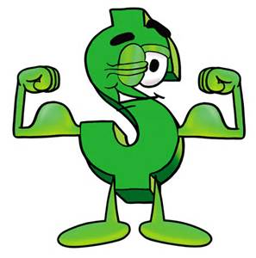
F.A.Q’s.
DO YOU TAKE INSURANCE?
NO
BUT ARE FAR LESS EXPENSIVE THAN ANY OTHER SETTING
NO MEDICAID/MEDICARE EITHER
DO YOU OFFER MEMBERSHIPS AND PACKAGES?
YES
MEMBERSHIPS ARE AVAILABLE
VITAMIN SHOTS CAN BE PURCHASED IN A PACKAGE

Slide 34
F.A.Q’s.
DO YOU DO PRIVATE PARTIES OR OFFER GROUP RATES?
YES. EITHER IN YOUR HOME OR IN THE CLINIC SETTING
WHERE DO YOU DELIVER YOUR OFF-SITE THERAPY?
PRIVATE HOMES
HOTELS
PRIVATE CLUBS
ANYWHERE YOU WANT US!

Slide 35
ARE THESE IV CLINICS SAFE?!?
GOOD QUESTION!
SPA-LIKE CLINICS SAY YES
OTHERS HAVE CONCERNS
THERE ARE CONCERNS REGARDING SCREENING FOR PROSPECTIVE CLIENTS
THERE ARE CONCERNS THAT CLIENTS ARE WASTING TIME IN A WAITING ROOM WHEN THEY HAVE A SERIOUS ILLNESS THAT NEEDS MEDICAL ATTENTION

Slide 36
HAVING A CURE FOR THE HANGOVER MAY ENCOURAGE INCREASED ALCOHOL CONSUMPTION
THERE ARE SOME CONCERNS THAT THE USE OF VITAMINS AND MINERALS IS UNREGULATED (FDA DOES NOT REGULATE VITAMINS, MINERALS, AND SUPPLEMENTS)
THERE IS CONCERN THAT THERE ARE IN-HOSPITAL SHORTAGES OF SOME NUTRIENTS LIKE B-12.
THROMBOPHLEBITIS AT SITE
NERVE DAMAGE
INFECTION LEADING TO ENDOCARDITIS
SOME DRUGS HAVE SIGNIFICANT SIDE EFFECTS
TORADOL (KETOROLAC) CAN CAUSE KIDNEY DAMAGE

Slide 37
“IT’S LIKE USING A BULLDOZER TO DO SOMETHING THAT YOU CAN DO WITH A SHOVEL.”
DR. GAIL D’ONOFRIO

Slide 38
THE PRO’s OF HYDRATION CLINICS?
CONVEINIENCE
ACCESS
COST
CHOICE
NO DR VISIT OR ER VISIT
AFTER AN ILLNESS LIKE THE FLU, STOMACH VIRUS, OR AFTER A HANGOVER, THESE REMEDIES MAY INDEED ASSIST THE PATIENT IN FEELING BETTER SOONER

Slide 39
THE CON’s OF HYDRATION CLINICS…
IT BY-PASSES THE OLD SYSTEM OF THE PHYSICIAN DECIDING WHAT THE PATIENT NEEDS
ASSESSMENTS ARE NOT ALWAYS COMPLETE
MANY OF THE TREATMENTS AT HYDRATION CLINICS CAN BE ACCOMPLISHED THROUGH LESS INVASIVE MEANS
IF THE CLIENT CAN DRINK, THE CLIENT CAN RE-HYDRATE
EATING FRUITS AND DRINKING JUICE MUCH LESS INVASIVE
CLAIMS MAY BE FALSE

Slide 40
LEGAL ISSUES
THEY JUST DON’T KNOW YET
THE MEDICAL COMMUNITY AT LARGE IS CONCERNED THAT
THE RISKS AREN’T WORTH THE SMALL BENEFIT
OVER THE COUNTER REMEDIES MAY WORK AS WELL OR BETTER IN SOME CASES
IS THE PLACEBO EFFECT IN OPERATION?

Slide 41
SOME THINGS FOR THE CONSUMER TO THINK ABOUT…
MAKE SURE THEY DO A THOROUGH ASSESSMENT
TELL THE TRUTH! (ABOUT YOUR HEALTH HISTORY)
WHAT KIND OF SKIN PREP? ARE THEY USING CURRENT STANDARDS OF PRACTICE?
SITE SELECTION
MANY USE ANTECUBITAL
WHO IS PREPARING THE FLUIDS?

Slide 42
CONTINUED…
ASEPSIS!!!!
PREPARE ACCORDING TO STANDARDS OF PRACTICE
(LIKE NOT IN YOUR HOME BATHROOM!)
CLEAN NEEDLES AND SYRINGES? ALCOHOL PADS/CHLORHEXIDINE?
WHO IS STARTING YOUR IV?
UNLICENSED PERSONNEL MAY INTRODUCE THEMSELVES AS “NURSES”

Slide 43
CONTINUED…
INFUSION CHAIRS AND INFECTION CONTROL
SOFT, WOVEN TEXTURES HARBOR PATHOGENS
INFUSION REACTIONS?

Slide 44
ONE MORE THING…
THE LPN MAY BE ALLOWED TO START IVS AND MONITOR THEM IN THESE SETTINGS IF AN RN IS PRESENT
THE LPN MAY NOT PUSH ANY OF THESE MEDICATIONS
IF IN DOUBT, CONTACT THE BOARD
CURRENT NPA DOES NOT TAKE THESE NEW AREAS INTO ACCOUNT
CURRENT GUIDELINES SHOULD BE FOLLOWED

Slide 45
REMEMBER!!!
REGARDLESS OF WHERE IV SERVICES ARE PROVIDED, THERE ARE STILL STANDARDS OF PRACTICE TO FOLLOW! IGNORANCE IS NO EXCUSE!

