Slide 1
Subcutaneous infusions
THINKING OUTSIDE OF THE VEIN

Slide 2
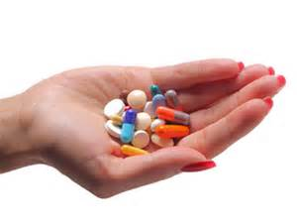
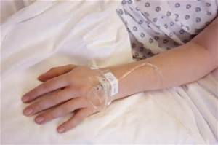
ADMINISTERING FLUIDS AND MEDICATIONS…
USED TO BE ACHIEVED THROUGH TWO MAIN ROUTES:
ORAL OR PO
IV OR INTRAVENOUSLY

Slide 3
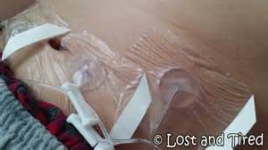
THERE IS ANOTHER WAY TO GIVE MEDS AND FLUIDS…
SUBCUTANEOUS INFUSION

Slide 4
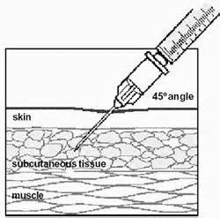
WHAT IS A SUBCUTANEOUS INFUSION?
IT IS AN INFUSION OF FLUID UNDER THE SKIN
A.K.A.
HYPODERMOCLYSIS
INTERSTITIAL INFUSION

Slide 5
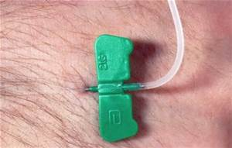
WHAT IS A SUBCUTANEOUS INFUSION?
THE NEEDLE IS INSERTED UNDER THE SKIN (IN THE SUBCUTANEOUS LAYER)
FLUID SLOWLY ENTERS THE INJECTION SITE
BY GRAVITY
BY PUMP
THE BODY ABSORBS THE MATERIAL SLOWLY
USEFUL WHEN LONG-TERM PAIN CONTROL IS DESIRED
ALSO USEFUL FOR SLOW-RELEASE MEDICATIONS LIKE INSULIN

Slide 6
WHY WOULD THE SUBCUTANEOUS INFUSION BE USED?
PATIENTS CANNOT TAKE MEDICATIONS ORALLY
PATIENTS CANNOT TAKE MEDICATIONS RECTALLY
PATIENTS HAVE POOR VENOUS ACCESS
SLOW ABSORPTION IS DESIRED
PALLIATIVE CARE FOR CLIENTS IN THE TERMINAL STAGES OF AN ILLNESS
PUMP DELIVERY OF INSULIN

Slide 7
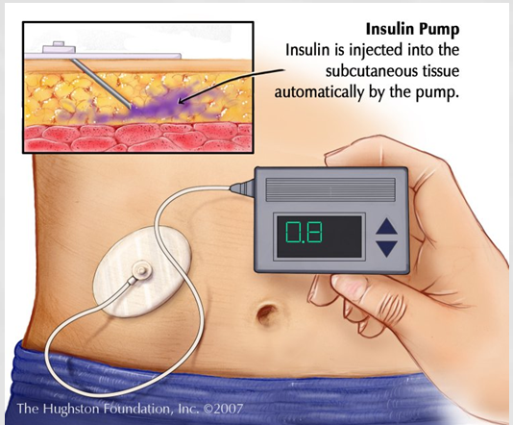
WHAT IS A SUBCUTANEOUS INFUSION USED TO TREAT?
DEHYDRATION
NAUSEA/VOMITING
END-OF-LIFE CARE
PAIN CONTROL
SIMPLE HYDRATION AS CLIENTS STOP EATING AND DRINKING
INSULIN PUMPS
DYSPHASIA, DELIRIUM, CONFUSION, STUPOR, SEIZURES

Slide 8
WHAT ARE THE ADVANTAGES OF SUBCUTANEOUS INFUSIONS?
LOW COST
NO SPECIAL TRAINING REQUIRED
MORE COMFORTABLE THAN IV ADMINISTRATION
LESS LIKELY TO CAUSE FLUID OVERLOAD
SIMPLE INSERTION
SUITABLE FOR IN-HOME CARE
NEEDS LESS SUPERVISION, LESS HOSPITALIZATION
CAN BE SET UP AND ADMINISTERED BY NURSES IN ALMOST ANY SETTING
DOES NOT CAUSE THROMBOPHLEBITIS
LOW RISK OF SEPTICEMIA OR SYSTEMIC INFECTION
CAN BE STARTED AND STOPPED AT ANY TIME BY OPENING AND CLOSING CLAMP ON TUBING; NO DANGER OF CLOT FORMATION

Slide 9
WHAT ARE THE DISADVANTAGESOF SUBCUTANEOUS INFUSIONS?
USUAL RATE ONLY 1 mL/hr = 3000 ml/24 hours
LIMITATIONS ON ADMINISTRATION OF ELECTROLYTES, NUTRITION ADDITIVES AND MEDICATIONS
EDEMA AT INFUSION SITE IS COMMON
POSSIBILITY OF LOCAL REACTIONS

Slide 10
ANY CONTRAINDICATIONS?
YES, BUT JUST A FEW
IF FLUIDS NEED TO BE ADMINISTERED RAPIDLY AND IN LARGE AMOUNTS
IF PATIENT AT SEVERE RISK OF PULMONARY CONGESTION (IN SEVERE HEART FAILURE)
IF PATIENT HAS CLOTTING DISORDERS
MAY BLEED AT SITE
DO NOT USE SUBCUTANEOUS INFUSION ON PATIENTS WITH
GENERALIZED BODY EDEMA
POOR PERIPHERAL CIRCULATION
MINIMAL SUBCUTANEOUS TISSUE
DO NOT USE DRUGS WHICH ARE IRRITATING TO THE TISSUE

Slide 11
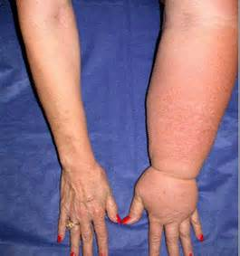
ALSO AVOID…
TISSUE WITH LYMPHEDEMA
BONY PROMINENCES
SKIN WITH RASH, BROKEN SKIN, INFLAMMATION OR INFECTION
TUMORS
LIMBS DISTAL TO KNEES OR ELBOWS
RECENTLY IRRADIATED SKIN SITES

Slide 12
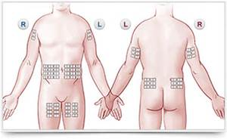
WHAT SITES CAN BE USED?
IN THE LOOSE SKIN OF THE UPPER BACK
ANTERIOR AND LATERAL ASPECTS OF THIGHS
OUTTER ARMS
BUTTOCKS
ABDOMEN
DO NOT USE THE ARM FOR HYPODERMOCLYSIS INFUSIONS
GENERALLY:
LOOK FOR AREAS WITH A GOOD DEPTH OF SUBCUTANEOUS FAT
DON’T USE SITES NEAR JOINTS
SELECT SITES THAT ARE AEASILY ACCESSIBLE (CHEST/ABDOMEN)

Slide 13
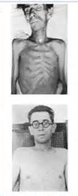
ALSO REGARDING SITES…
SITES WILL BE ROTATED
SELECTION IS INFLUENCED BY WHETER THE PATIENT IS
AMBULATORY
AGITATED AND/OR DISTRESSED
CHEST OR ABDOMEN ARE PREFERRED
UPPER, ANTERIOR CHEST WALL ABOVE BREAST, AWAY FROM AXILLA
IF PATIENT CACHECTIC, USE ABDOMEN

Slide 14
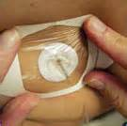
SITE CARE
ROTATE SITES WHEN CHANGING NEEDLES
CHANGE SITES 72 HRS TO 14 DAYS
LONGEVITY OF SITE INFLUENCED BY:
TYPE OF MEDICATION
TYPE OF CANNULA USED
pH OF SOLUTION
INFECTION
PROLONGED PRESENCE OF FOREIGN BODY IN SKIN
CHANGE SITE IF LOCAL REACTION DEVELOPS

Slide 15
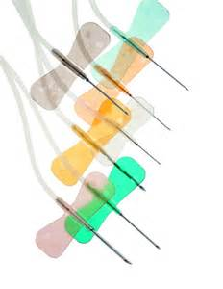
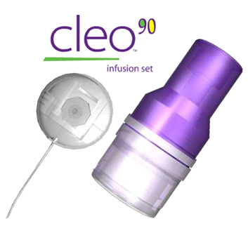
EQUIPMENT NEEDED
LABEL
PUMP IF INDICATED
IV TUBING
EXTENSION SET
IV START KIT
CHLOROHEXADINE OR 70% ISOPROPYL ALCOHOL
TRANSPARENT DRESSING
2 X 2 OR 4 X 4 GAUZE DRESSING/SPONGES
DISPOSABLE GLOVES
24 GAUGE, 5/8” CATHETER
NORMAL SALINE FLUSH
NON ALLERGIC TAPE
SKIN PREP

Slide 16
WHAT ABOUT INFORMED CONSENT?
GOOD QUESTION!
IN HOSPICE PATIENTS ESPECIALLY………
INFORMED CONSENT SHOULD INCLUDE:
PURPOSE OF USING SUBCUTANEOUS FLUIDS
THAT THE UNDERLYING DISEASE PROCESS WILL CONTINUE AND THAT FURTHER DETERIORATION MAY BE DUE TO THIS RATHER THAN REDUCED FLUID INTAKE
HOW THE DECISION WILL BE MADE TO STOP THE INFUSION
POSSIBLE EDEMA
POSSIBLE INCREASE IN AIRWAY SECRETIONS CAUSING “DEATH RATTLE”
POSSIBLE INCREASE IN GI SECRETIONS CAUSING INCREASE IN V/V
POSSIBLE NEED FOR URINARY CATHETER

Slide 17
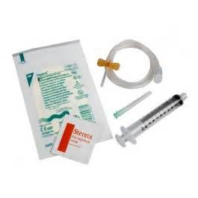
PROCEDURE
ALL OF “THE USUAL”
DON GLOVES
CLEAN SELECTED SITE WITH CHLOROHEXADINE OR ALCOHOL
ALLOW TO DRY
PREPARE EXTENSION TUBING AND PRIME WITH SALINE
USE 24G 5/8” PROTECTIVE CATHETER
STABILIZE TISSUE WITH FREE HAND, HOLDING IT FLAT, IN A NATURAL POSITION
INSERT NEEDLE AT 30-45 DEGREE ANGLE WITH BEVEL UP, ALMOST UP TO HUB

Slide 18
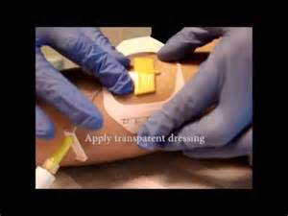
CONTINUED…
CHECK FOR BLOOD RETURN—THERE SHOULD BE NONE
IF BLOOD IN TUBING—REMOVE AND REPEAT IN DIFFERENT SITE
SECURE WITH TAPE
USE SKIN PREP TO PREPARE IT FOR TRANSPARENT DRESSING
APPLY TRANSPARENT DRESSING OVER INSERTION SITE
LABEL SITE
NOT FOR IV INFUSION
ADJUST FLUID/MEDICATION RATE AS PRESCRIBED
IF PUSHING, FOLLOW MED WITH 1 ML NS FLUSH
EXAMINE SITE EVERY 8 HOURS FOR SWELLING, REDNESS, PAIN, AND FLUID LEAKAGE
CHANGE SITES AS NEEDED

Slide 19
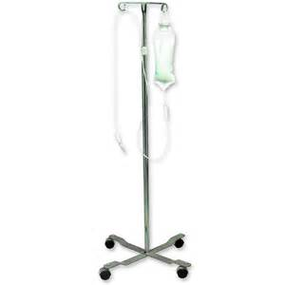
VOLUME AND RATE
BY GRAVITY OR PUMP
GENERALLY:
ABOUT 1.5 L CAN BE DELIVERED AT ANY ONE SITE
MAXIMUM 2 L OVER 24 HOURS
BOLUSES OF 500 ML CAN BE GIVEN
TIMING:
CONTINUOUSLY
OVERNIGHT
IN BOLUSES OF 500 ML PER HOUR, 2-3 X DAILY

Slide 20
TEACHING
PATIENT AND FAMILY EDUCATION INCLUDES:
EXPLANATION AND EDUCATION ABOUT WHAT HE DEVICE WILL DO
ADVANTAGES AND POSSIBLE DISADVANTAGES
SAFETY
ASEPSIS
TROUBLESHOOTING GUIDELINES

Slide 21
PATIENT ASSESSMENT AND TROUBLESHOOTING GUIDELINES
UTILIZE THE RIGHTS OF MEDICATION ADMINISTRATION
MAKE SURE DRUGS BEING DELIVERED ARE COMPATIBLE
IF USING A PUMP (ESPECIALLY IN THE HOME SETTING) HAVE SPARE BATTERIES AVAILABLE
ASSESS CLIENT REGULARLY
DOCUMENT SYMPTOM CONTROL AND EVALUATE INTERVENTIONS
CAREFULLY INSPECT SITE EVERY 4-8 HOURS
INSPECT TUBING FOR PATENCY
INSPECT SITE FOR TENDERNESS
HEMATOMA
LEAKING

Slide 22
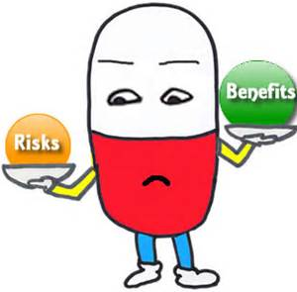
ADVERSE EFFECTS OF HYPODERMOCLYSIS INCLUDE:
LOCAL EDEMA
MOST COMMON EFFECT; CAN BE RESOLVED BY MASSAGE
LOCAL CATHETER REACTIONS
PAIN OR DISCOMFORT AT SITE
RARE
CAN BE RELATED TO INSERTION OF NEEDLE DEEPER THAN SUBCUTANEOUS LAYER
INCREASE IN INFUSION RATE
CELLULITIS
GOOD ASEPSIS CAN PREVENT THIS
PUNCTURE OF BLOOD VESSELS
MINIMAL RISK, THERE SHOULD BE NO BLOOD RETURN WHEN STARTING INFUSION

Slide 23
ADVERSE EFFECTS CONTINUED…
PULMONARY EDEMA
RARE
REPORTED IN 0.6% OF MORE THAN 600 PATIENTS
CHANGE IN PLASMA CONCENTRATION OF ELECTROLYTES
RARE
LESS COMMON THAN WITH IV INFUSION

Slide 24
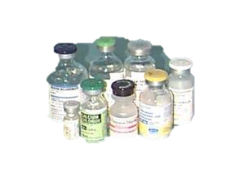
COMMONLY ADMINISTERED DRUGS
MORPHINE
HALOPERIDOL
METHOTRIMEPRAZINE
SEDATION, END-OF-LIFE RESTLESSNESS/DELIRIUM/INTRACTABLE PAIN
N/V
SCOPOLAMINE
SOME BENZODIAZEPINES
PHENOBARBITAL
HYALURONIDASE
INSULIN

Slide 25
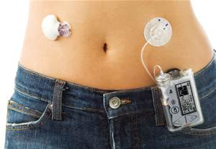
THE INSULIN PUMP
SAME BASIC TECHNIQUE
INFUSION SET IS CHANGED EVERY 2-3 DAYS
SITES ARE ROTATED (JUST LIKE GIVING INSULIN INJECTIONS!)
ABDOMEN IS PREFERRED BECAUSE THE ABSORPTION IS MORE RAPID AND CONSISTENT

Slide 26
WHO CAN HAVE A PUMP?
PATIENTS WITH:
A1C>7.0-7.5%, ACCOMPANIED BY FREQUENT SEVERE HYPOGLYCEMIA (<70 MG/dL)
HYPOGLYCEMIC EVENTS REQUIRING THIRD PARTY ASSISTANCE
HYPOGLYCEMIA INTERFERING WITH WORK, SCHOOL, OR FAMILY OBLIGATIONS
FREQUENT AND UNPREDICTABLE FLUCTUATIONS IN BLOOD GLUCOSE LEVELS
PATIENT PERCEPTION THAT DIABETES MANAGEMENT IMPEDES THE PURSUIT OF PERSONAL OR PROFESSIONAL GOALS
WHEN INTERMITTENT INSULIN INJECTIONS ARE NOT MEETING TREATMENT GOALS AND OUTCOME MEASURES ARE SUB-OPTIMAL

Slide 27
PUMP USERS MUST BE ABLE TO…
CHANGE INFUSION SETS
FILL PUMP CARTRIDGES
PROGRAM THE PUMP
MUST BE WILLING TO WORK WITH HEALTH CARE TEAM TO ACHIEVE GOALS OF THERAPY
NEED SUFFICIENT EDUCATION AND SUPPORT
MUST CHECK BLOOD GLUCOSE AT LEAST 4X DAILY
MUST HAVE COMMITMENT AND COMPETENCE TO PERFORM BASIC DIABETES SELF-MANAGEMENT BEHAVIORS

Slide 28
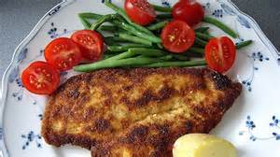
ONE REALLY GREAT THING…
PUMP USERS MAY SKIP OR DELAY MEALS
MAY BE FLEXIBLE ON AMOUNT OF CARBS CONSUMED AT ONE TIME
MEALTIME INSULIN IS DELIVERED MORE LIKE PEOPLE WITHOUT DIABETES
RELEASED IN RESPONSE TO BLOOD SUGAR RISE

Slide 29
ANY PROBLEMS?
DISCOMFORT WITH INSERTION
USUALLY RESOLVES
ASEPSIS IS CRITICAL!
IF:
ANY ABNORMAL DISCOMFORT IS FELT, CHANGE THE SET AND SITE
CALL THE DOCTOR:
REDNESS/HARDNESS/TENDERNESS AROUND SITE
OOZING FROM CANNULA SITE
WARM TO TOUCH
IF INFECTION OCCURS:
USUALLY STAPH AND REQUIRES ORAL ANTIBIOTIC
ASEPSIS!
IF ABSCESS OCCURRS, INCISE, DRAIN, CULTURE
RULE OUT MRSA

Slide 30
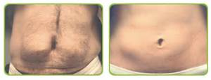
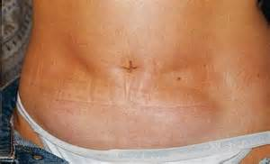
A COUPLE OF OTHER THINGS…
LIPODYSTROPHY AND LIPOHYPERTROPHY
ROTATE!!
WAIT 3-4 WEEKS BEFORE RE-USING SITE
USUALLY NOT DANGEROUS, BUT ARE COSMETICALLY UNDESIRABLE

Slide 31
MECHANICAL PROBLEMS
CAN CAUSE HYPOGLYCEMIA OR HYPERGLYCEMIA OR DKA
INFUSION SITE PROBLEMS
DISPLACED OR CLOGGED INFUSION SETS
INACTIVATED INSULIN BECAUSE OF DEGRADATION
PUMP MALFUNCTION

Slide 32
HYPERGLYCEMIA

Slide 33
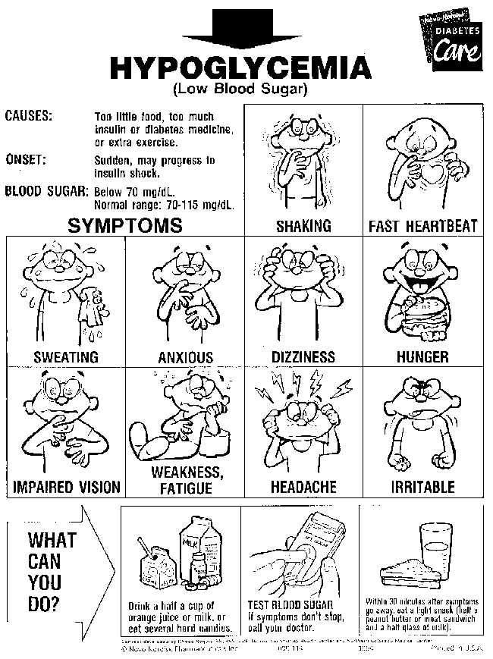
HYPOGLYCEMIA

Slide 34
DIABETIC KETOACIDOSIS
DEVELOPS WHEN YOUR BODY CAN'T PRODUCE ENOUGH INSULIN.
INSULIN NORMALLY PLAYS A KEY ROLE IN HELPING SUGAR (GLUCOSE) — A MAJOR SOURCE OF ENERGY FOR YOUR MUSCLES AND OTHER TISSUES — ENTER YOUR CELLS.
WITHOUT ENOUGH INSULIN, YOUR BODY BEGINS TO BREAK DOWN FAT AS FUEL.
THIS PROCESS PRODUCES A BUILDUP OF ACIDS IN THE BLOODSTREAM CALLED KETONES
EVENTUALLY LEADING TO DIABETIC KETOACIDOSIS IF UNTREATED
DKA CAN BE SERIOUS AND CAN LEAD TO DEATH

Slide 35
DIABETIC KETOACIDOSIS

Slide 36
WHAT ABOUT THE LPN AND SUBCUTANEOUS INFUSIONS?
GENERALLY:
LPN’S ASSESS SITES
PERFORM SITE CARE AS NEEDED
MONITOR THE SUBCUTANEOUS SITE AND INFUSION
HANG ADDITIONAL SOLUTIONS FOR HYPODERMOCLYSIS FOR SIMPLE REHYDRATION
MAY DISCONTINUE THE INFUSION AND REMOVE THE NEEDLE UPON MD’S ORDERS
CANNOT ADMINISTER OPIODS VIA SUBCUTANEOUS PUSH, PCA OR CONTINUOUS DRIP

Slide 37
IN CONCLUSION…
THE SUBCUTANEOUS ROUTE MAY BE COMING TO A FACILITY NEAR YOU!
IT IS MUCH LESS INVASIVE
IT IS MUCH LESS COSTLY
AND IT CAN BE VERY EFFECTIVE IN DELIVERY OF INSULIN AND OTHER DRUGS

